Slide 1
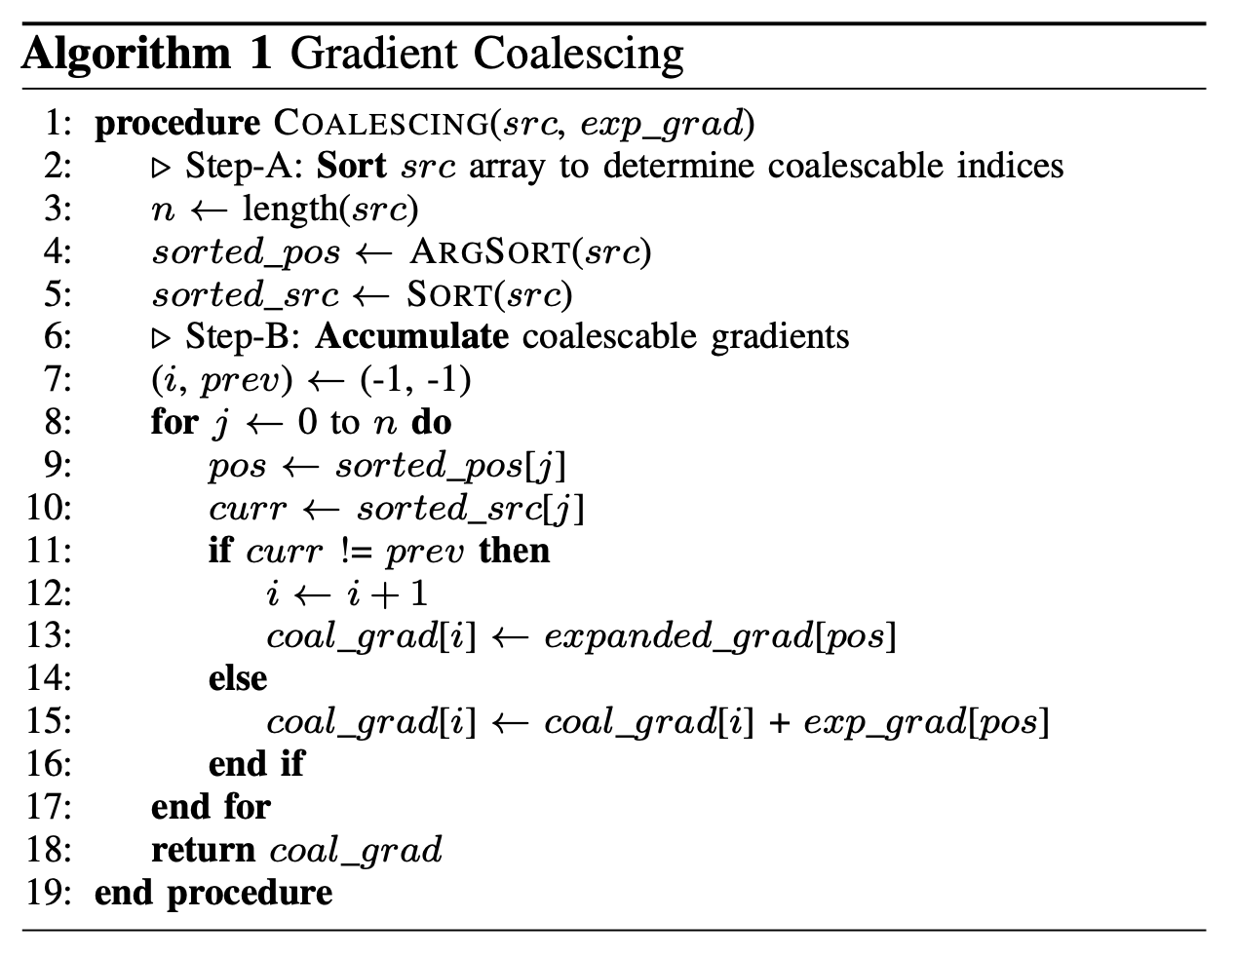














$$src=(1, 2, 4, 0, 2)$$
$$SORT(src)$$
$$sorted_src=(0, 1, 2, 2, 4)$$
$$Step−A: SORT src array$$
$$pos=(0, 1, 2, 3, 4)$$
$$ARGSORT(src)$$
$$n−1$$
$$sorted_pos=(3, 0, 1, 4, 2)$$
$$exp_grad=(0, 0, 0, 1, 1)$$
$$Step−B:ACCUMULATE$$
$$coal_grad=(G\left[1\right], G\left[0\right], G\left[0\right]+G[1], G[0])$$
$$prev$$
$$prev←curr$$
$$sorted_src=(0, 1, 2, 2, 4)$$
$$curr$$

Slide 2
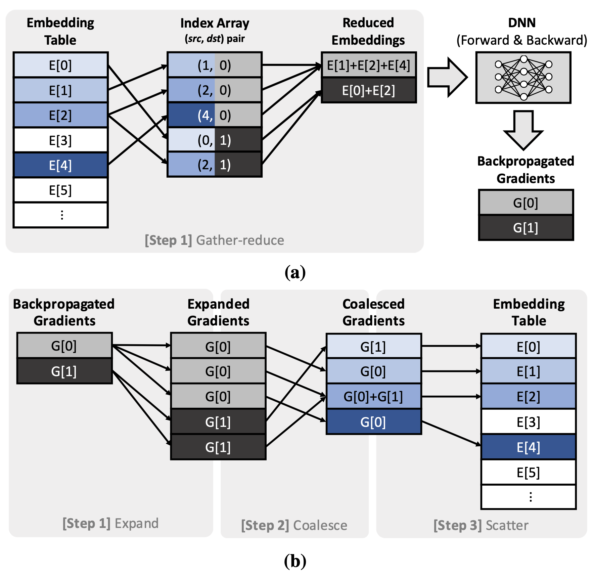


$$src$$
$$exp⁡_grad$$

Slide 3
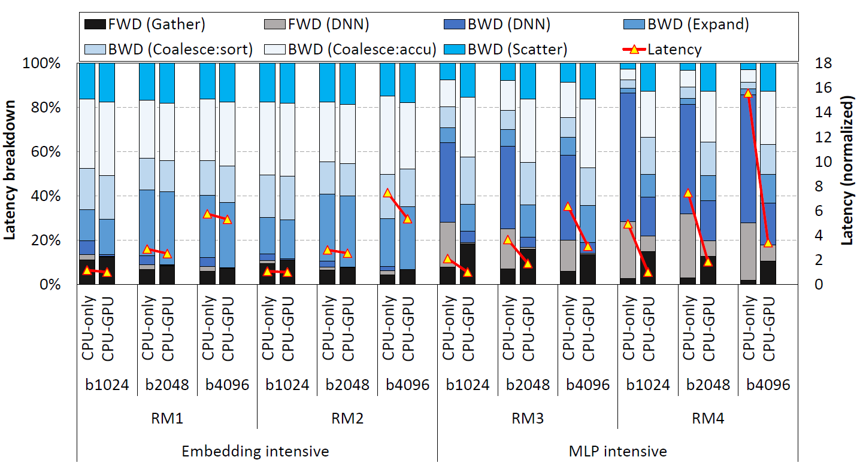

Slide 4
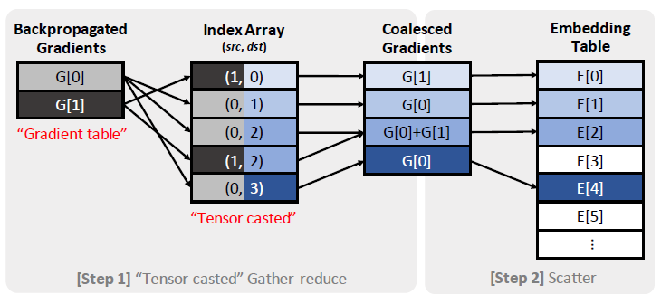


$$GatherReduce$$
$$Tensor Casting$$
Separate the operations: Tensor casting can be done before finishing forward propagation
Even if we do not know gradients, we can make the index array
Due to tensor casting, the latency of sorting can be hidden in the forward propagation
Question: I thought the main memory bottleneck is scatter operation but it is not.. Is really scattering is okay for memory access latency, i.e. for irregular memory access pattern?

Slide 5
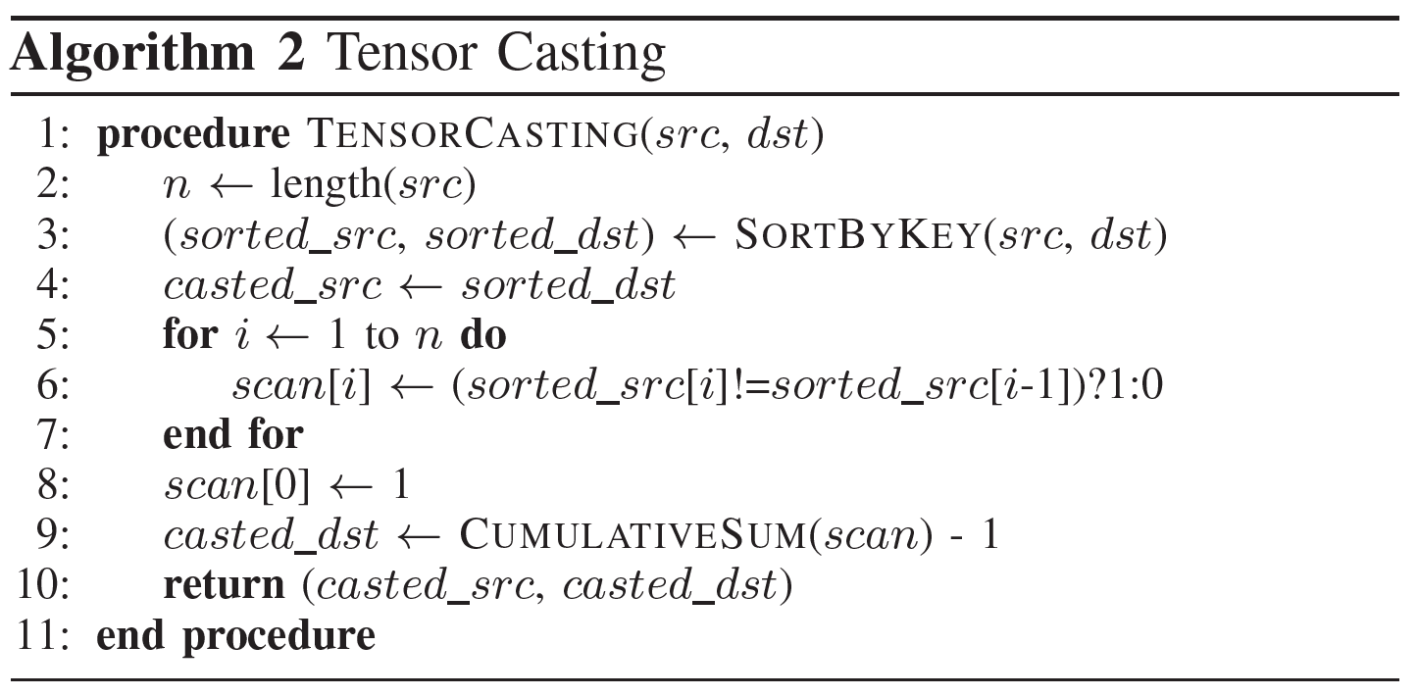
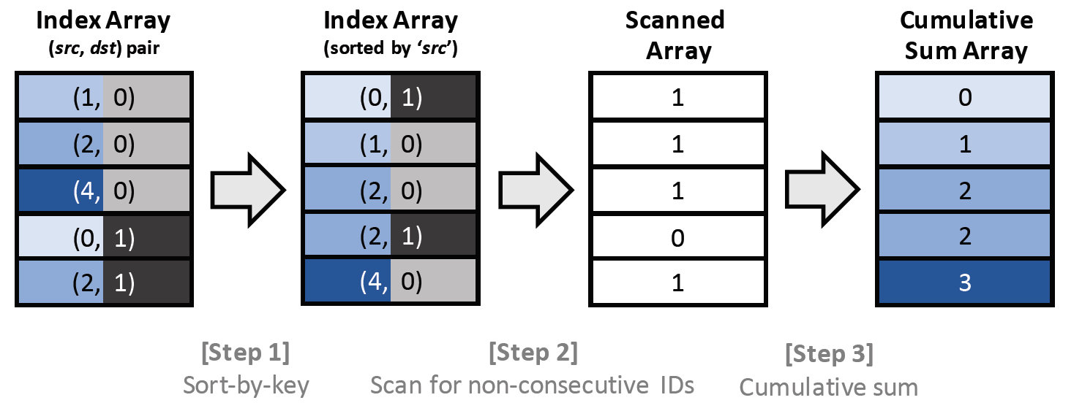





$$"Tensor casted"$$
$$=Tensor casted$$
$sorted_dst$ = $casted_src$
$$sorted_src$$
$$casted_dst$$

Slide 6
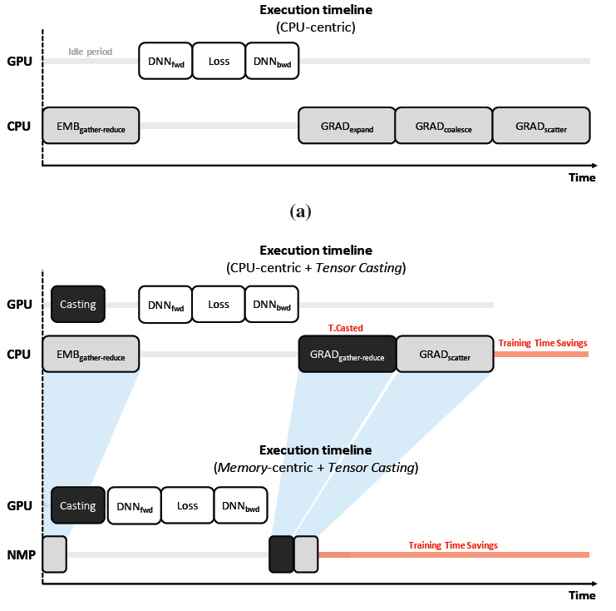
Q. How about do casting in CPU at a case of memory-centric + tensor casting?

Slide 7
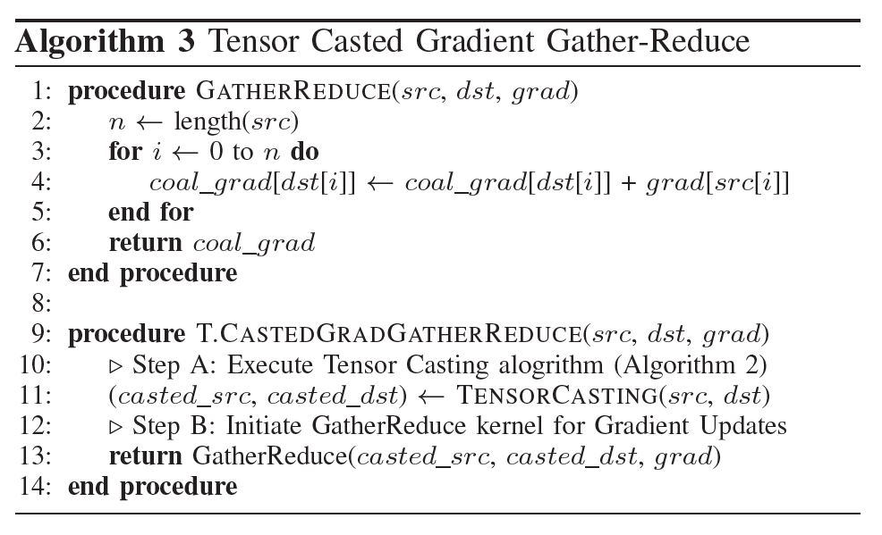

Slide 8
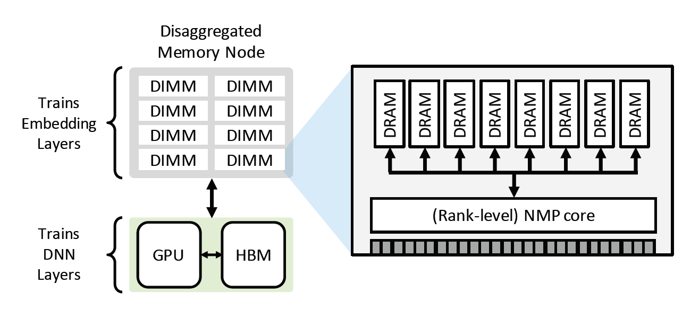

Slide 9
